Slide 1
Entity Resolution
Simon Garrett PhD
https://sheridanandbairns.com/

Slide 2
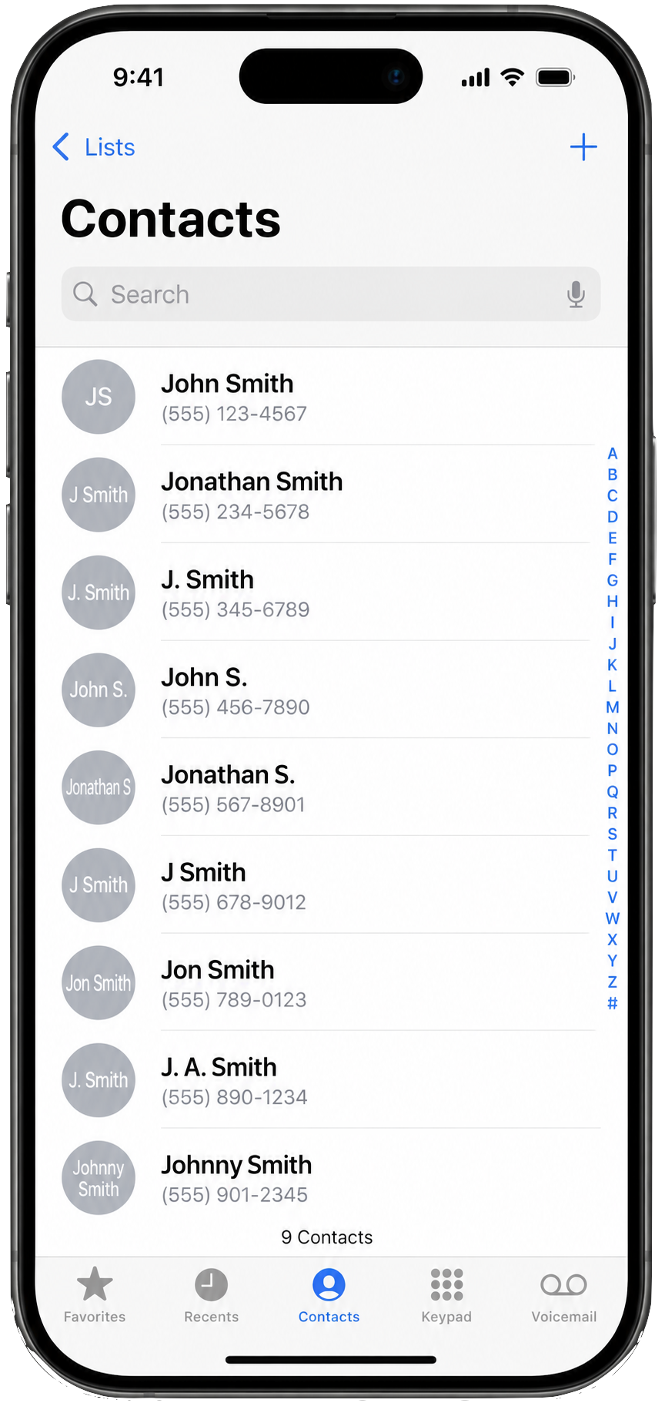
The ER Problem
Who has a phone that looks something like this?
How many unique people are in this list?
  1 ?
  9 ?
  Nobody knows ?

Slide 3
Simple Matching Fails
1 – Both “John Smith”: could easily be the same person.
2 – Variants: Could still be the same person
3 – More information: now it’s less likely that the two John Smith’s are the same person. Or is it one person with two addresses?
If we get it wrong in Cyber or NatSec, we either have:
  a false positive (an innocent person is investigated
  a false negative (an attacker is hidden)
Record A Record B
John Smith John Smith
Jon Smyth Jonathan S
John Smith, Bristol John Smith, Cardiff

Slide 4
Scaling
What’s worse is we may have multiple
files, feeds, APIs ...
all with different formats
HR system
VPN logs
Badge access
IP access
Threat intel feed
Watchlists
We need to resolve the records into entities representing the same person or thing
This is Entity Resolution
Phone: 100s of records. One hyper-focused person can fix it, in principle
CRM: 1,000s of records. Possible, maybe, to code something that filters to a smaller number for a human to deal with
Customer DB: Millions of records. Only a fully automated solution is viable
UK Gov: Billion+ records. Even checking correctness of the automated system is a problem.

Slide 5
Cyber Example
Data:
Threat intelligence: jsmith@example.com
VPN logs: john.smith@gmail.com
HR: Jonathan Smith
Access Card System: J Smith
Without ER: Four disjoint records.
With ER: The same person
Bad actors are aware that ER is difficult. They deliberately give altered or false data
But they only have to get sloppy once for us to:
merge two piece of information via ER
challenge them about the false information
And merges accumulate reach.
Also applies to:
  Insider threat
  Fraud (AML, KYC)
  Criminal Networks
  Sanctioned entities
  State-sponsored actors

Slide 6
Solution: Joint Evidence
More than one field: If available, use email, address, phone, ID, name, relationships, etc.
Some fields match better: An ID (like passport number) > email address > name > gender
  Cardinality: How many values? NI No vs gender.
  Values per entity? One passport, multi emails
  Changability: NI Num stays the same and should be unique, email address/phone can change
We can start to build an automated system that takes these things in to account.
When we have two records that match on passport number, it’s a strong match.
If they only match on first name it’s a much weaker match.
We can quantify this and calculate a match score.

Slide 7
A Big Bump In The Road
Going back to scaling, consider what our new system needs to do.
It needs to compare every records with every other records and check for a match.
This is very quickly intractable:
  100 => 10,000 comparisons – do-able
  1,000 => 1M comparisons – automatable
  10K => 100M comparisons - painful
  1M => 1T comparisons - impossible
  1B => 1Quintillion – oh dear
100x100
1,000x1,000
10,000x10,000

Slide 8
Solution: Blocking
If we can’t do all comparisons: we need a way to home-in on those that are more likely — without false pos or neg.
Create candidate groups: Only compare records with the same:
  Postcode outcode: E.g. ‘SW12”
  Email domain: E.g. “example.com”
  Surname (part or whole): “Smith” or “Smi”
  Phone prefix: “01432”
  Perhaps combine, e.g: name + DoB
Examine all candidate groups
Analogy:
If you were looking for a friend in
London, you wouldn’t check every
human on earth, you’d look for people
in the UK
with a similar surname
about the right age
etc.

Slide 9
Existing Systems
Clearly ER is a complex undertaking: there are established systems.
  Senzing: Used across UK Gov and elsewhere. A ‘black box’ solution for many users. Good name matching beyond what you might expect.
  Splink: from MoJ. More of a ‘lego’ approach that needs expertise to put together, but highly effective and fast.
  Quantexa: Big in fin crime and intel. Its network visualisations are a big feature.
  Palantir: ER is fundamental to Foundry and Gotham. I question how good it really is...
  Me! Stuff I do for consulting.
Bespoke?
You would not believe the number of organisations who think they can build their own ER system.
Almost certainly they cannot.
As you have seen it’s highly complex
But actually, it’s way worse, with many edge cases.
It’s cheaper to buy in an existing solution (just avoid Palantir, IMO!)

Slide 10
Conclusion
When your phone merges two copies of John Smith, that's entity resolution.
When a bank identifies a fraud ring, or an intelligence analyst connects infrastructure to an actor, or a cyber team links activity across dozens of systems, it's the same problem.
The difference isn't the mathematics. It's the scale.
QUESTIONS?

